Slide 1
Section 2.5
Variation
Copyright © 2012 Pearson Education, Inc. Publishing as Prentice Hall.

Slide 2

Copyright © 2012 Pearson Education, Inc. Publishing as Prentice Hall.

Slide 3

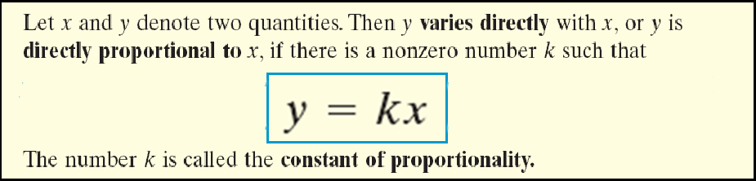
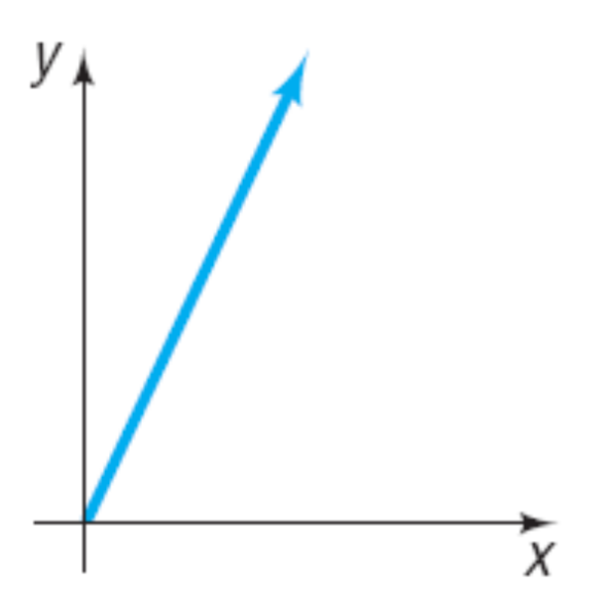

Copyright © 2012 Pearson Education, Inc. Publishing as Prentice Hall.

Slide 4


The monthly payment p on a mortgage varies directly with the amount borrowed B. If the monthly payment on a 30-year mortgage is $5.95 for every $1000 borrowed, find a formula that relates the monthly payment p to the amount borrowed B for a mortgage with these terms. Then find the monthly payment p when the amount borrowed B is 125,000.
$125,000
Because p varies directly with B, p = kB for some constant k.
Because p = 5.95 when B = 1000, 5.95 = k(1000).
k = 0.00595
0.00595
(125,000)
p = k B
p = $743.75
Copyright © 2012 Pearson Education, Inc. Publishing as Prentice Hall.

Slide 5
Copyright © 2012 Pearson Education, Inc. Publishing as Prentice Hall.

Slide 6

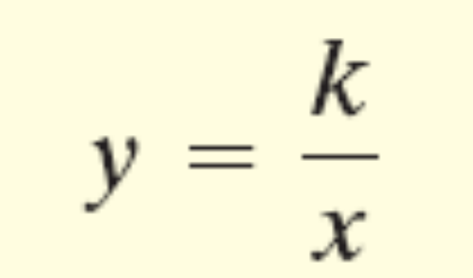
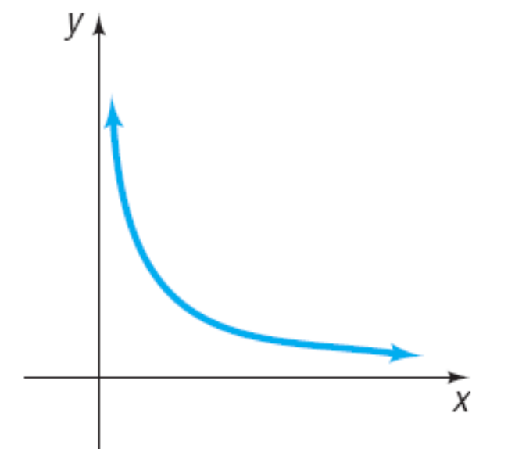
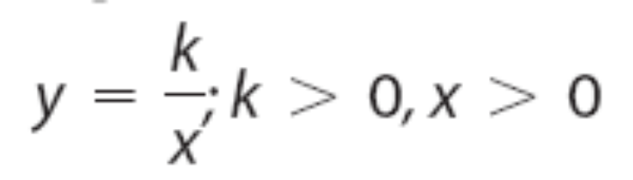
Copyright © 2012 Pearson Education, Inc. Publishing as Prentice Hall.

Slide 7
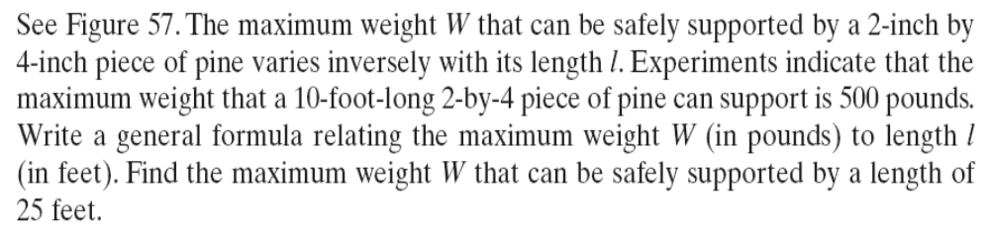
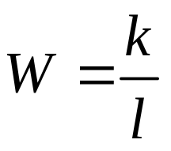
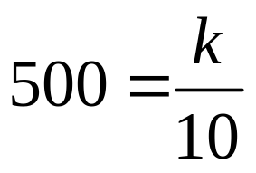

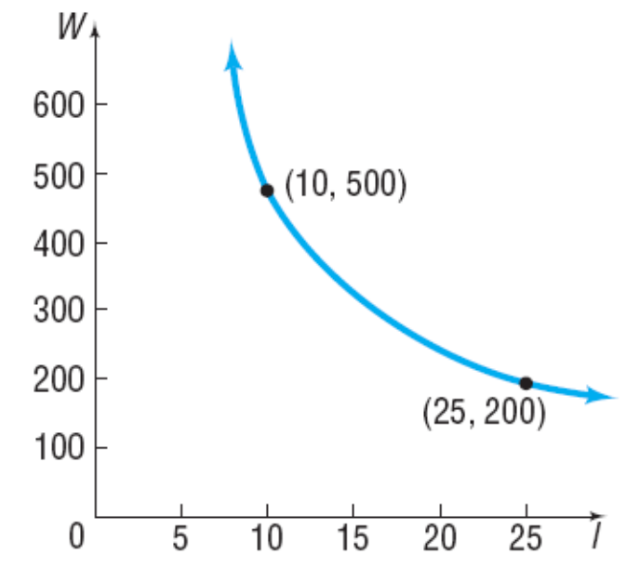

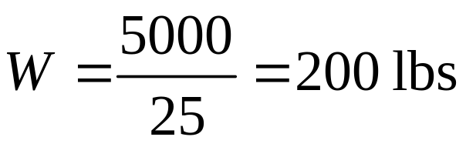
Copyright © 2012 Pearson Education, Inc. Publishing as Prentice Hall.

Slide 8

Copyright © 2012 Pearson Education, Inc. Publishing as Prentice Hall.

Slide 9

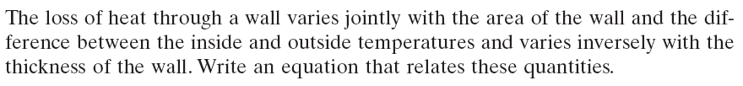
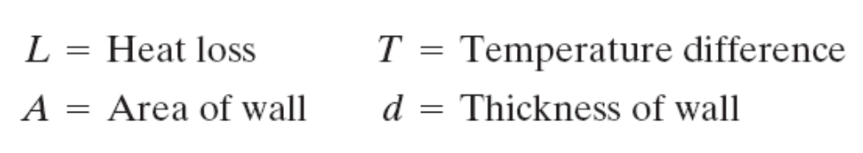
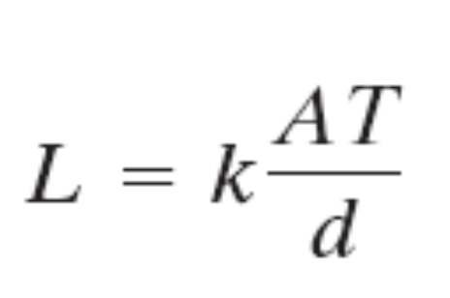
Copyright © 2012 Pearson Education, Inc. Publishing as Prentice Hall.

Slide 10
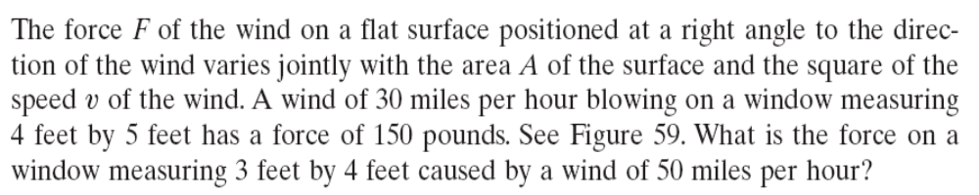


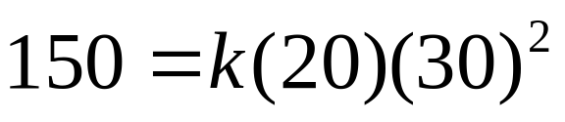
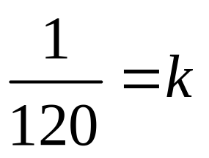

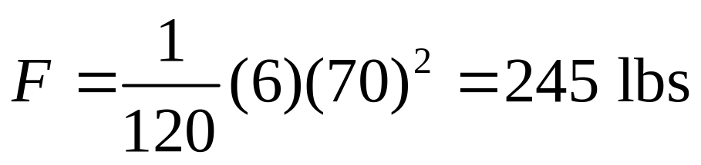
2
3
70
Copyright © 2012 Pearson Education, Inc. Publishing as Prentice Hall.

